Slide 1

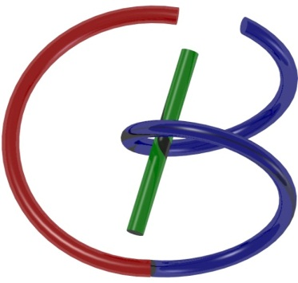
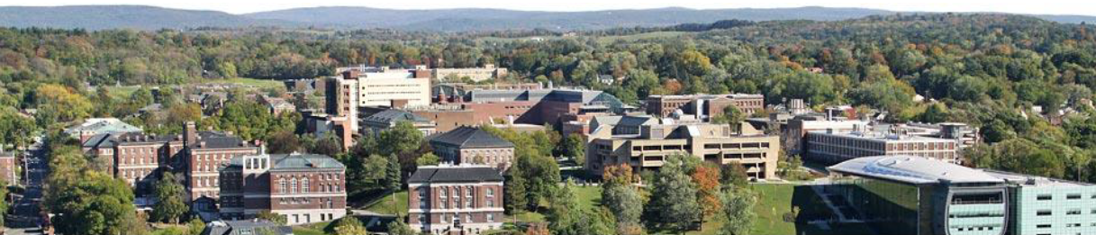
38655 BMED-2300-02
Lecture 11: Quality Assessment
Ge Wang, PhD
Biomedical Imaging Center
CBIS/BME, RPI
wangg6@rpi.edu
February 27, 2018

Slide 2
BB Schedule for S18
Tue | Topic | Fri | Topic
1/16 | Introduction | 1/19 | MatLab I (Basics)
1/23 | System | 1/26 | Convolution
1/30 | Fourier Series | 2/02 | Fourier Transform
2/06 | Signal Processing | 2/09 | Discrete FT & FFT
2/13 | MatLab II (Homework) | 2/16 | Network
2/20 | No Class | 2/23 | Exam I
2/27 | Quality & Performance | 3/02 | X-ray & Radiography
3/06 | CT Reconstruction | 3/09 | CT Scanner
3/20 | MatLab III (CT) | 3/23 | Nuclear Physics
3/27 | PET & SPECT | 3/30 | MRI I
4/03 | Exam II | 4/06 | MRI II
4/10 | MRI III | 4/13 | Ultrasound I
4/17 | Ultrasound II | 4/20 | Optical Imaging
4/24 | Machine Learning | 4/27 | Exam III
Office Hour: Ge Tue & Fri 3-4 @ CBIS 3209 | wangg6@rpi.edu
Kathleen Mon 4-5 & Thurs 4-5 @ JEC 7045 | chens18@rpi.edu

Slide 3
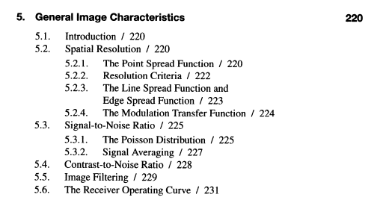
5th Chapter

Slide 4
Outline
General Measures
MSE
KL Distance
SSIM
System Specific
Noise, SNR & CNR
Resolution (Spatial, Contrast, Temporal, Spectral)
Artifacts
Task Specific
Sensitivity & Specificity
ROC & AUC
Human Observer
Hotelling Observer
Neural Network/Radiomics

Slide 5
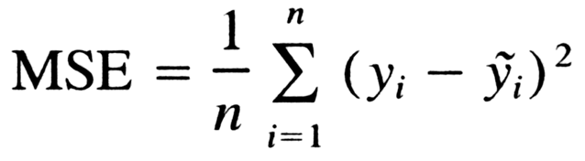

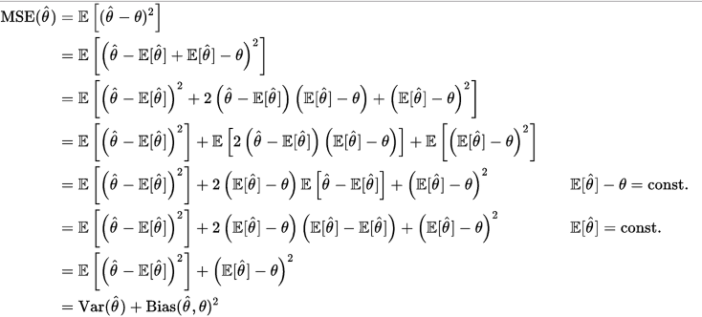
Mean Squared Error
Many y_{i}
One θ

Slide 6
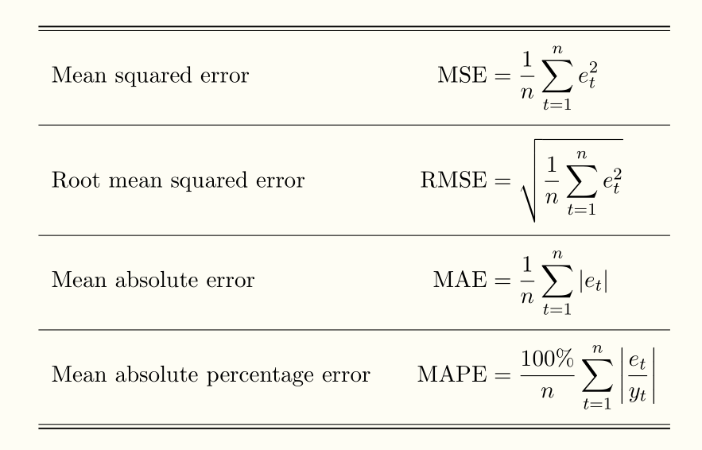
More Variants

Slide 7
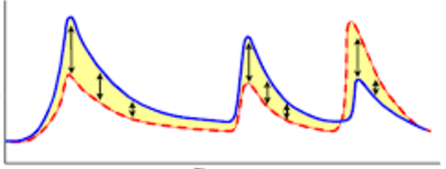
Very Reasonable!

Slide 8

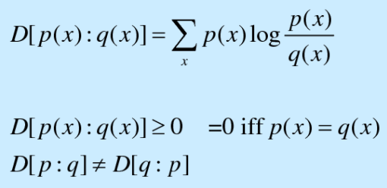
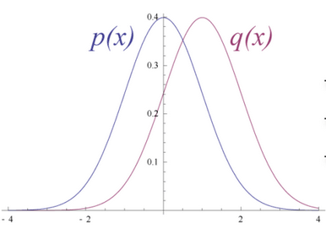
Information Divergence
Kullback-Leibler Distance

Slide 9
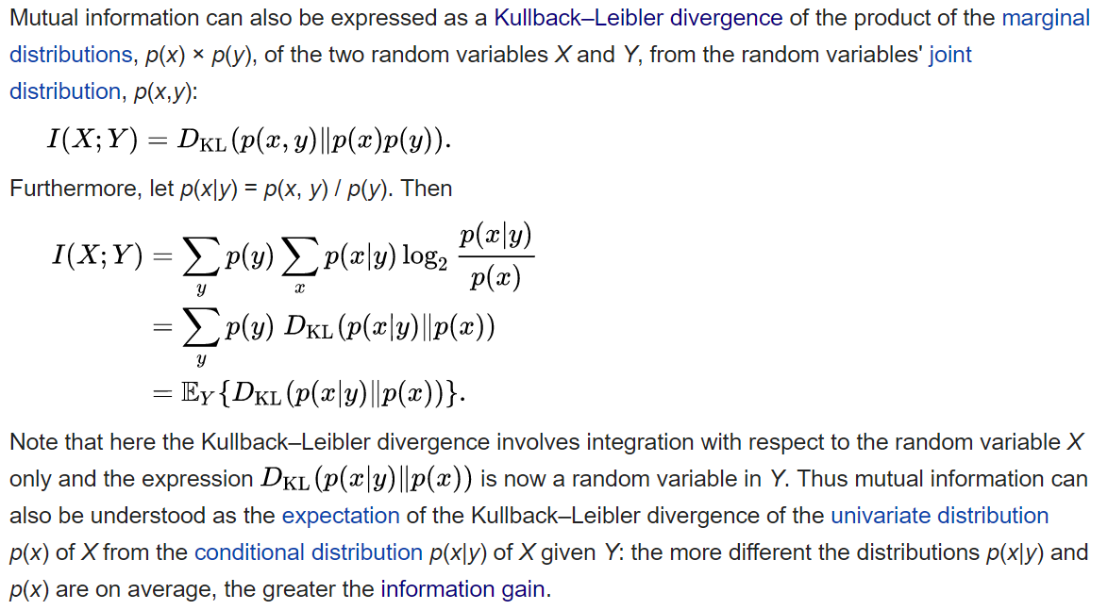
Mutual Info as K-L Distance

Slide 10
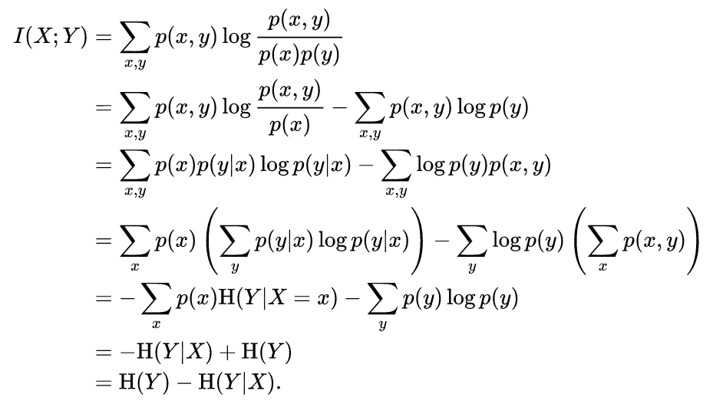
Entropy

Slide 11
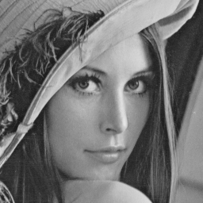

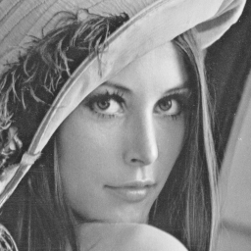
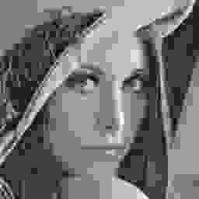

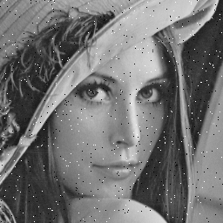
Observation: MSE=225

Slide 12
Philosophy
HVS Extracts Structural Information
HVS Highly Adapted for Contextual Changes
Classical | “New”
Bottom-up | Top-down
Error Visibility | Structural Distortion
How to define structural information?
How to separate structural & nonstructural info?

Slide 13
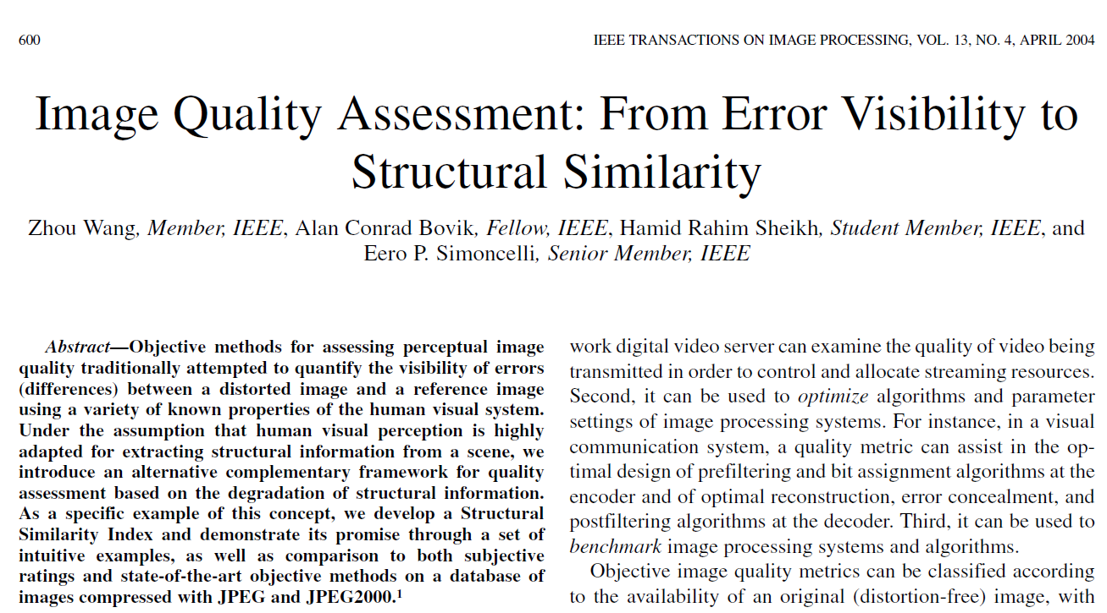
Instant Classic

Slide 14
Example
SSIM=1
SSIM=0.949
SSIM=0.989
SSIM=0.671
SSIM=0.688
MSSIM=0.723

Slide 15
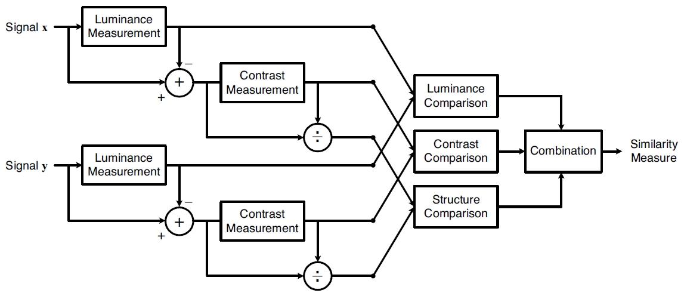
Structural Similarity

Slide 16
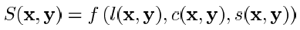
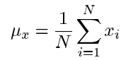
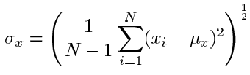
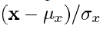
Similarity: Luminance, Contrast, & Structure

Slide 17
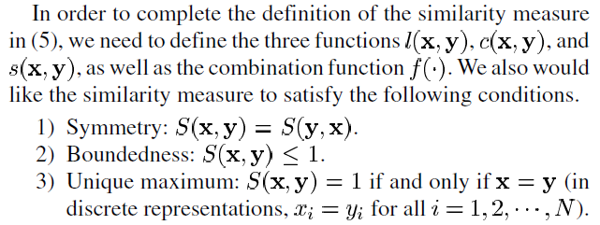
Three Postulates

Slide 18
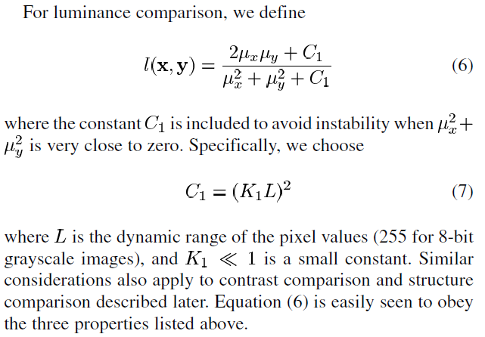
Luminance Comparison

Slide 19
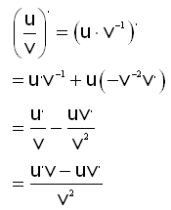
Analysis on Luminance Term

Slide 20
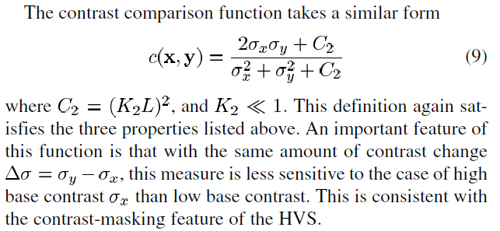
Contrast Comparison

Slide 21
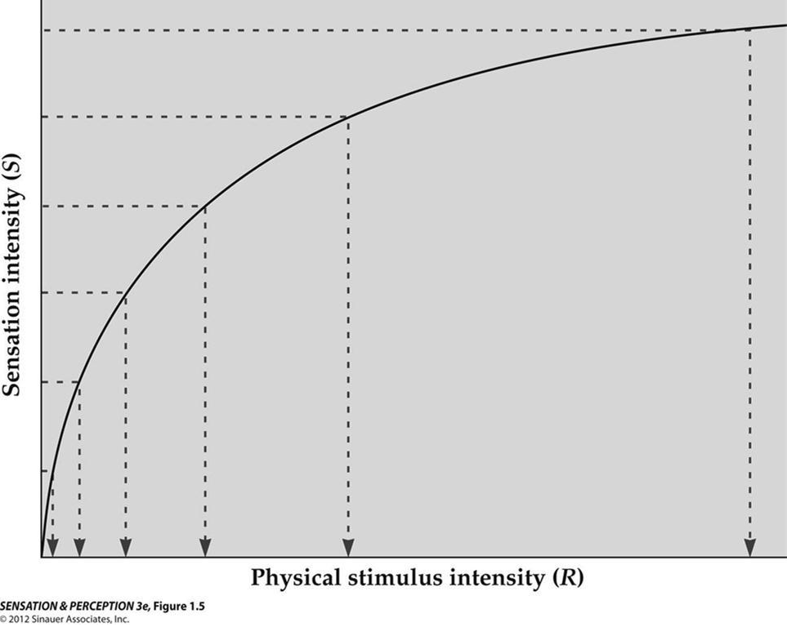
Analysis on Contrast Term
Weber’s law, also called Weber-Fechner law, historically important psychological law quantifying the perception of change in a given stimulus. The law states that the change in a stimulus that will be just noticeable is a constant ratio of the original stimulus. It has been shown not to hold for extremes of stimulation.

Slide 22
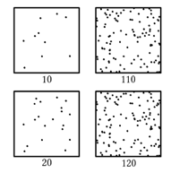
Change over Background

Slide 23
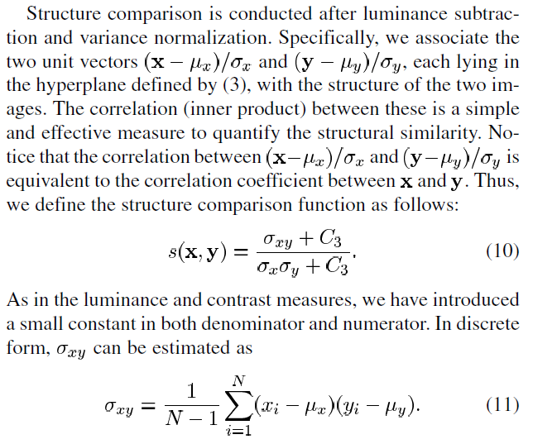
Structural Comparison

Slide 24
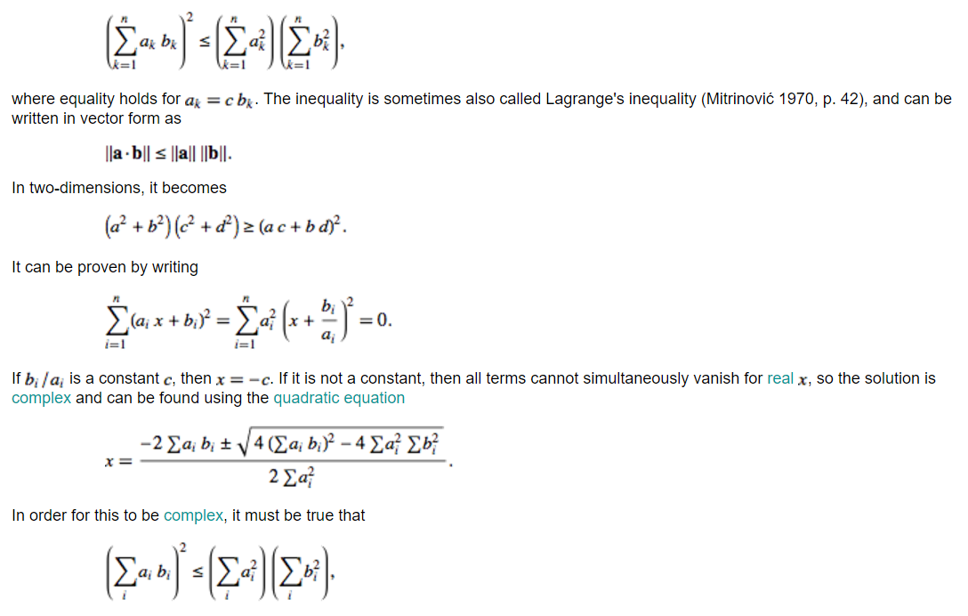

Cauchy–Schwarz Inequality

Slide 25
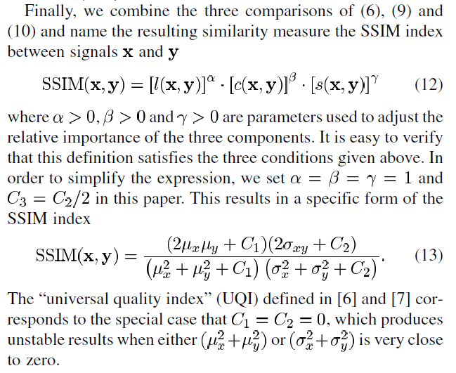
SSIM Is Born!

Slide 26
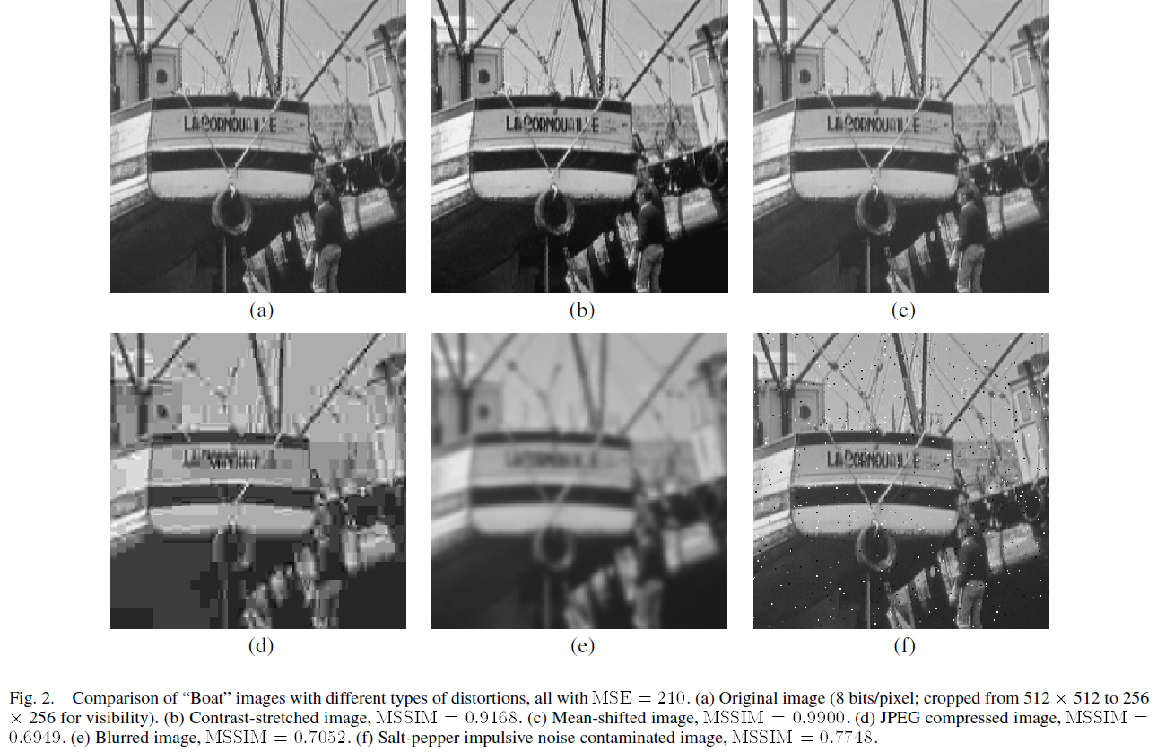
Example

Slide 27
SSIM Extensions
Color Image Quality Assessment
Video Quality Assessment
Multi-scale SSIM
Complex Wavelet SSIM
Toet & Lucassen, Displays, ’03
Wang, et al., Signal Processing: Image Communication, ’04
Wang, et al., Invited Paper, IEEE Asilomar Conf. ’03
Wang & Simoncelli, ICASSP ’05

Slide 28
Comments on Exam 1 in S’18

Slide 29
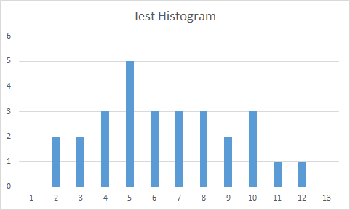
Comments on Exam 1 in S’17
2 : 95-90
3 : 90-85
4 : 85-80
5 : 80-75
6 : 75-70
7 : 70-65
8 : 65-60
9 : 60-55
10: 55-50
11: 50-45
12: 45-40

Slide 30
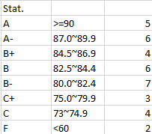
Grading Policy & Distribution’16
Grading Policy
The final grade in this course will be based on the student total score on all components of the course. The total score is broken down into the following components:
Class participation: 10%
Exam I: 20%
Exam II: 20%
Exam III: 20%
Homework: 30%
Subject to further calibration

Slide 31
Outline
General Measures
MSE
KL Distance
SSIM
System Specific
Noise, SNR & CNR
Resolution (Spatial, Contrast, Temporal, Spectral)
Artifacts
Task Specific
Sensitivity & Specificity
ROC & AUC
Human Observer
Hotelling Observer
Neural Network/Radiomics

Slide 32
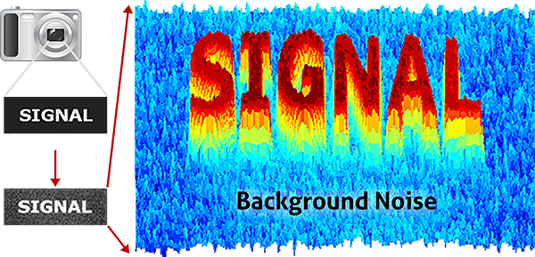
Signal to Noise Ratio (SNR)

Slide 33
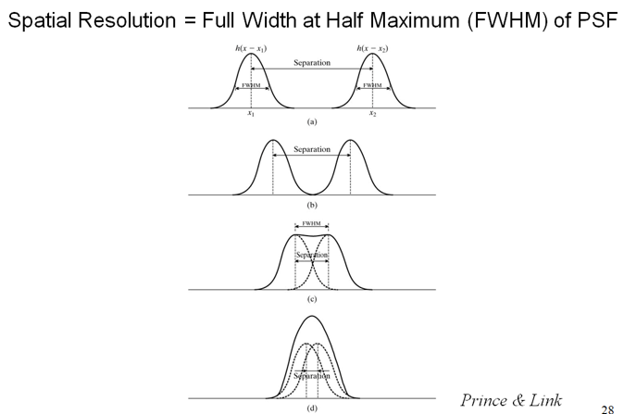
Spatial Resolution

Slide 34
Modulation Transfer Function

Slide 35
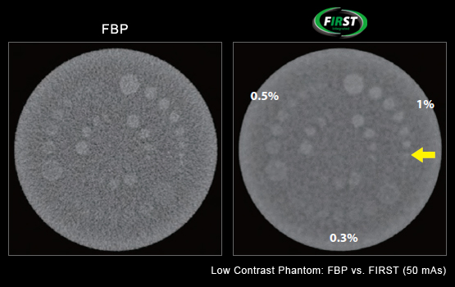
Contrast Resolution

Slide 36
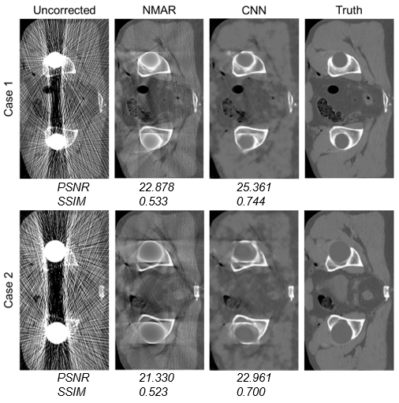
Metal Artifacts

Slide 37
Outline
General Measures
MSE
KL Distance
SSIM
System Specific
Noise, SNR & CNR
Resolution (Spatial, Contrast, Temporal, Spectral)
Artifacts
Task Specific
Sensitivity & Specificity
ROC & AUC
Human Observer
Hotelling Observer
Neural Network/Radiomics

Slide 38
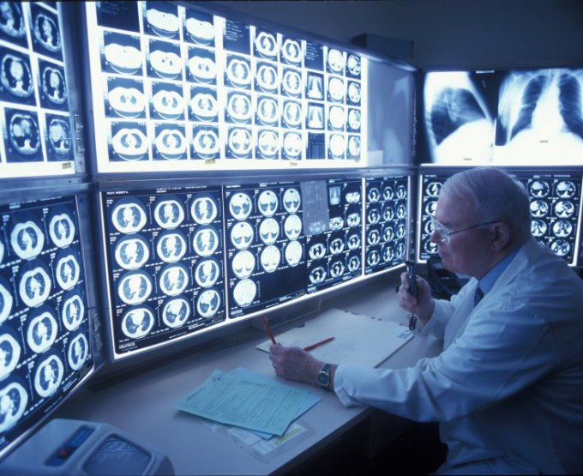
Need for Task-specific Measures

Slide 39
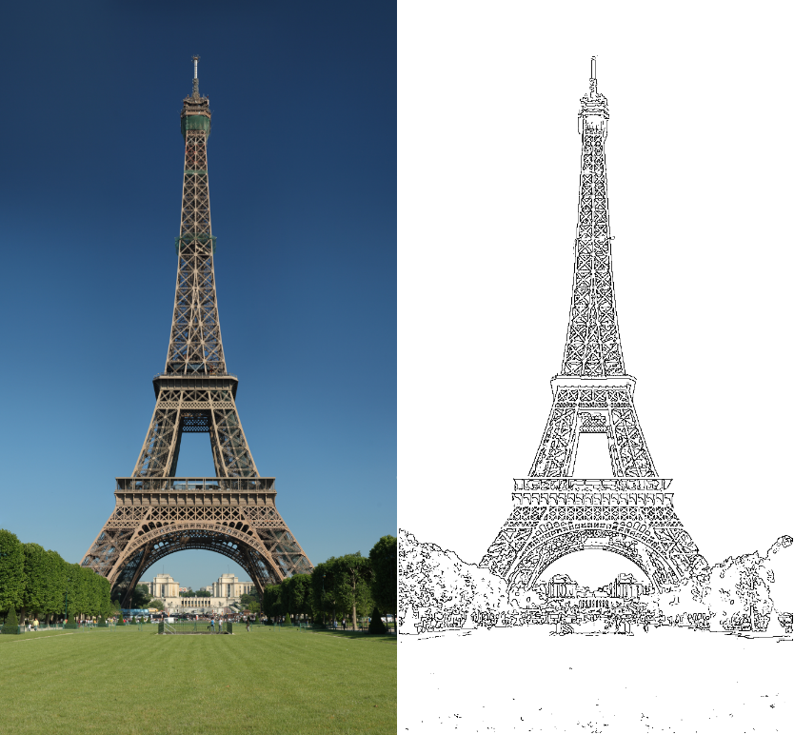
Four Cases (Two Error Types)
Edge Not
Not Edge
True Positive | False Negative
False Positive | True Negative

Slide 40
Sensitivity & Specificity
Likelihood of a positive case
Or % of edges we find
How sure we say YES
Sensitivity=TP/(TP+FN)
Likelihood of a negative case
Or % of non-edges we find
How sure we say NOPE
Specificity =TN/(TN+FP)

Slide 41
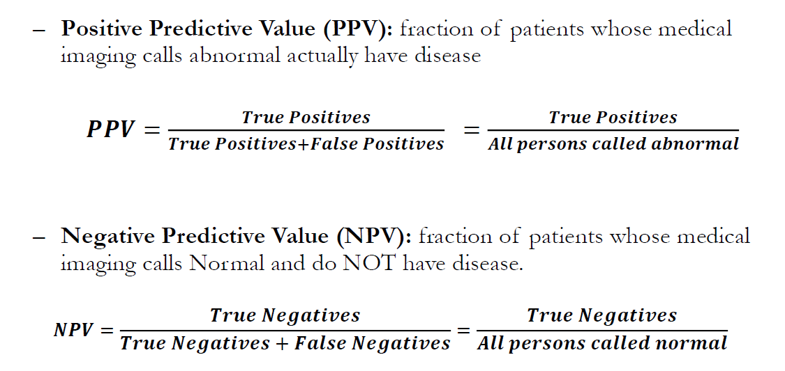
PPV & NPV

Slide 42
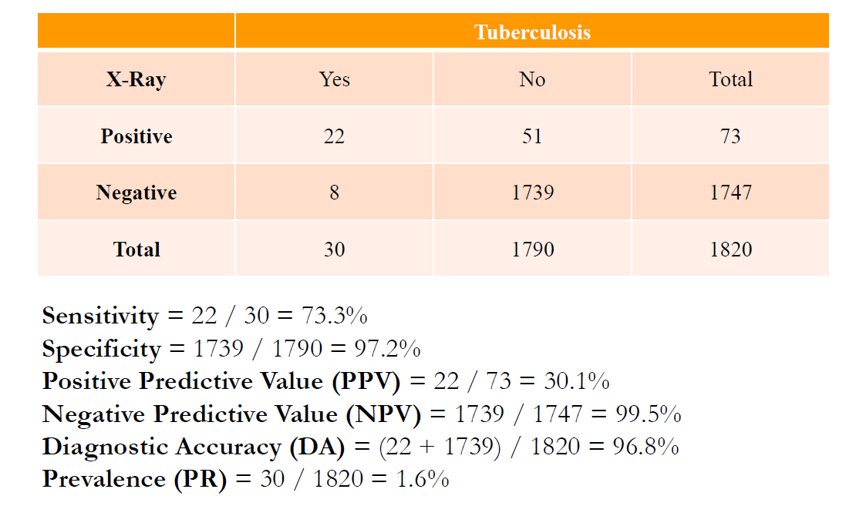
Example

Slide 43
Receiver Operating Characteristic
Report sensitivity & specificity
Give an ROC curve
Average over many data
Sensitivity
Any detector on this side can do better by flipping its output
1-Specificity

Slide 44
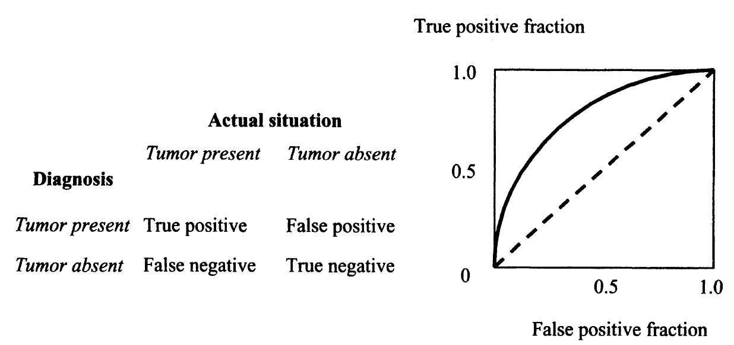
TPF vs FPF

Slide 45
Ideal Case
Non-diseased
Diseased
Threshold

Slide 46
More Realistic Case
Non-diseased
Diseased

Slide 47
ROC: Less Aggressive
Non-diseased
TPF, Sensitivity
Diseased
FPF, 1-Specificity

Slide 48
ROC: Moderate
Non-diseased
TPF, Sensitivity
Diseased
FPF, 1-Specificity

Slide 49
ROC: More Aggressive
Non-diseased
TPF, Sensitivity
Diseased
FPF, 1-Specificity

Slide 50
ROC Curve
Non-diseased
TPF, Sensitivity
Diseased
FPF, 1-Specificity
Example Adapted from Robert F. Wagner, Ph.D., OST, CDRH, FDA

Slide 51

Diagnostic Performance
51
Chance Line
TPF, Sensitivity
Reader Skill
Technology Power
FPF, 1-Specificity
Same Thing But
Viewed Differently

Slide 52
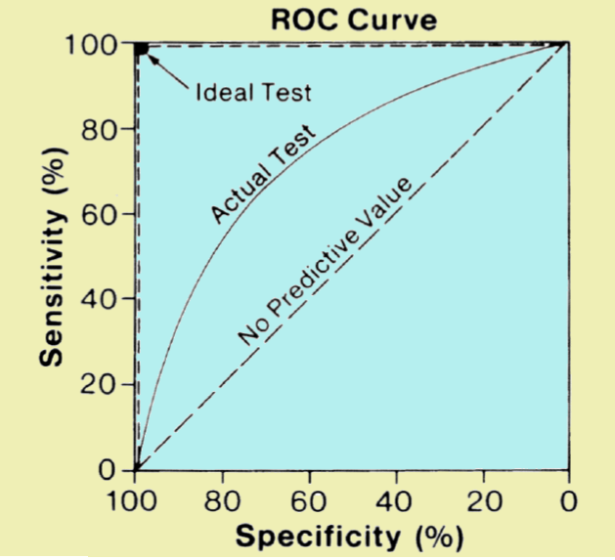
Area Under Curve
Area under ROC Curve (AUC)

Slide 53
Example
TPF vs FPF for 108 US radiologists in study by Beam et al.

Slide 54
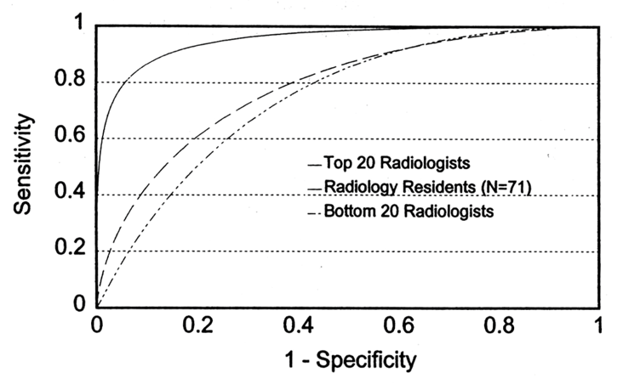
Example
Chest film study by E. James Potchen, M.D., 1999

Slide 55
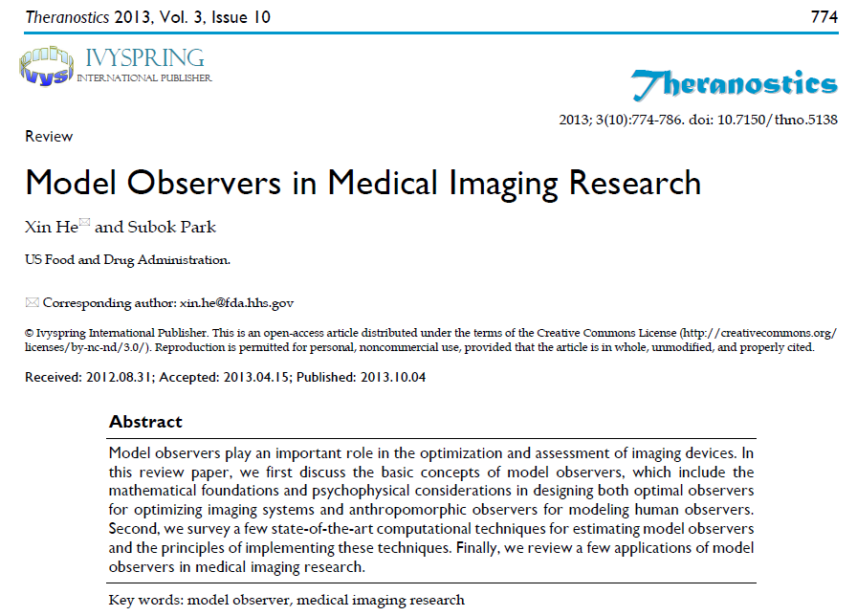
Model Observers

Slide 56
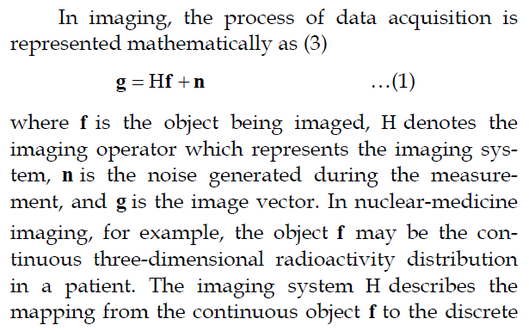
Imaging Model

Slide 57
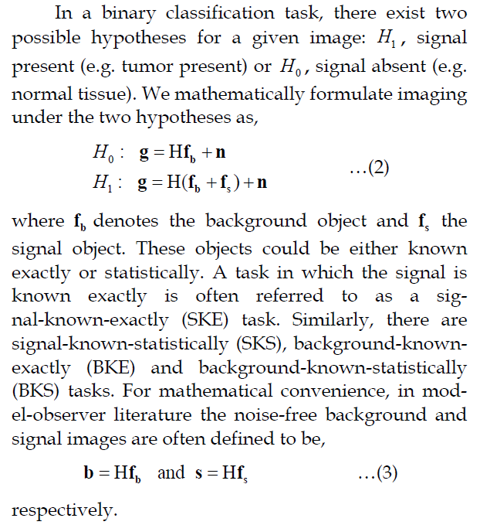
Binary Classification

Slide 58
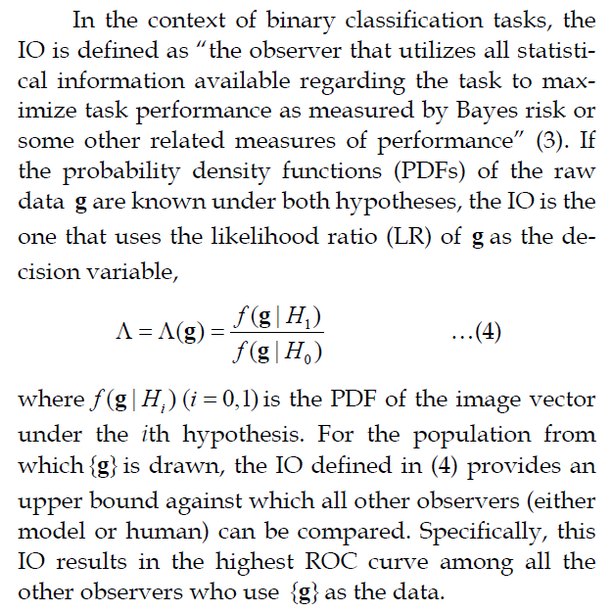
Ideal Observer

Slide 59
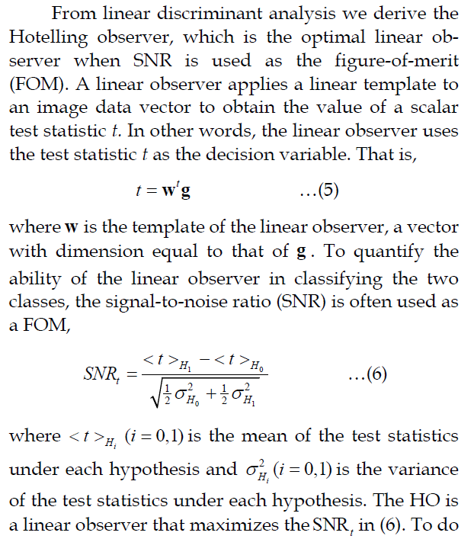
Hotelling Observer

Slide 60
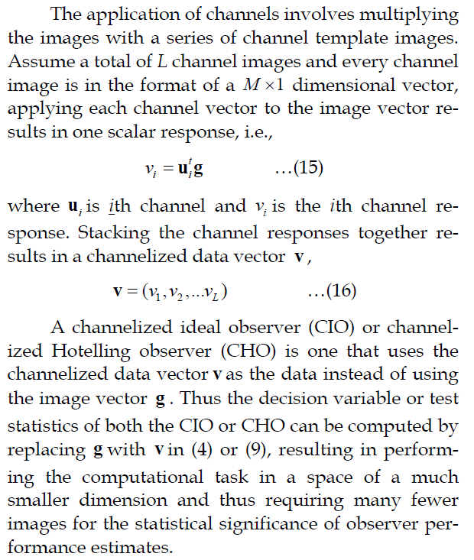
Channelized Observer

Slide 61

Four Channels

Slide 62

Radiomics

Slide 63

Nonlinear Observer

Slide 64

Supervised Learning
https://www.youtube.com/watch?v=kNPGXgzxoHw

Slide 65

Fuzzy XOR Problem

Slide 66

Deep Radiomics
https://www.nature.com/articles/s41598-017-05848-2.pdf

Slide 67




BB11 Homework
Use the MatLab code on http://www.cns.nyu.edu/~lcv/ssim/
to compute SSIM of the two photos (or other two photos):
Compute sensitivity and specificity
Make an example so that sensitivity and specificity are 90% and 80% respectively
Due Date: Same (Week Later)

